Slide 1
Institute Analytics Data Warehouse
Submitted By:
Ayan Khan
Technologies: Python | SQLite | Pandas | Power BI

Slide 2
Introduction
Educational institutions generate large volumes of academic and administrative data.
Managing this data across multiple files and systems can lead to inconsistency and reporting challenges.
This project creates a centralized Data Warehouse using SQLite and Python.
The system enables efficient storage, analysis, and visualization of institutional data using SQL analytics and Power BI dashboards.
Key Benefits
Centralized data storage
Faster reporting
Better decision-making
Improved data consistency
Enhanced institutional performance analysis

Slide 3
Problem Statement
Educational institutions often store data in multiple files and systems.
This creates several challenges:
Data is scattered across different sources
Difficulty in generating reports quickly
Lack of centralized analytics
Time-consuming manual analysis
Limited visibility into institutional performance
Why is a Data Warehouse Needed?
• Data exists in multiple sources.
• Reports take time to generate manually.
• Data consistency is difficult to maintain.
• Management lacks a single view of institutional performance.
• Decision-making becomes slower without analytics..

Slide 4
Objectives
The main objectives of this project are:
To design an Institute Data Warehouse
To collect and integrate institutional data
To implement ETL (Extract, Transform, Load) processes
To store data efficiently in a database
To perform analytical queries using SQL
To visualize institutional performance using Power BI
To support data-driven decision making
Generate institutional KPIs and performance metrics.
Build interactive dashboards for management reporting.

Slide 5
ETL Process Diagram
Extract
Extract • Read data from CSV files Transform • Data cleaning • Data validation • Format standardization Load • Store processed data into SQLite warehouse Benefits • Improved data quality • Consistent reporting • Faster analysis
Transform
• Clean Data
• Validate
• Standardize
Load
SQLite Warehouse

Slide 6
System Architecture
Data Sources
Students Data (500 Records)
Admissions Data (500 Records)
Attendance Data (500 Records)
Exam Results (500 Records)
Placements Data (300 Records) Faculty Data (50 Records) Quality Metrics (5 Records) Departments Data (5 Records)
ETL Process
Extract
Transform
Load
SQLite Warehouse
SQL Analytics
The architecture integrates multiple institutional data sources into a centralized warehouse for analytics and visualization.
Power BI Dashboard

Slide 7
Technologies Used
Programming Language — Python
Database — SQLite
Data Processing Libraries — Pandas , NumPy
Analytics — SQL Queries
Visualization — Power BI
Development Tools — VS Code , GitHub
Version Control — Git & GitHub

Slide 8
Database Design
The Data Warehouse contains the following tables : :
Tables Created
Database Type: Relational Data Warehouse
Total Tables: 8 Relationships:
Students linked with Attendance
Students linked with Exam Results
Students linked with Placements
Students linked with Departments
Students - Student Information
Departments - No. of courses
Admissions - Admission Records
Attendance - Attendance Tracking
Exam Results - Academic Performance
Placements - Placement Details
Faculty - Faculty Information
Quality Metrics - Institutional KPIs
Advantages
Structured data storage
Easy retrieval of information
Efficient analytical processing

Slide 9
Analytical Queries & Insights
Query 1 | Department-wise Student Count
Query 2 | Average Attendance Percentage
Query 3 | Pass vs Fail Analysis
Query 4 | Placement Distribution by Company
Query 5 | Average Placement Package
Query 6 | Department-wise Average Attendance
Query 7 | Department-wise Average Marks
Query 8 | Department-wise Placement Count
Key Insights
Information Technology department has the highest student count (78).
Overall average attendance is 76.58%.
Pass percentage is 94.2%.
Wipro recorded the highest number of placements.
Average placement package is 7.66 LPA.
AI & Data Science department achieved the highest average marks .
Mechanical Engineering recorded strong placement performance.

Slide 10
Power BI Dashboard
KPI Cards
Total Students
Total Departments
Placement Records
Average Package
Visualizations
Students by Department
Placements by Company
Pass vs Fail Analysis
Interactive Features
Department Filter (Slicer)
Dynamic Dashboard Updates
Visual Data Exploration
Benefits
Easy monitoring of institutional performance
Quick access to important metrics
Improved reporting and analysis

Slide 11
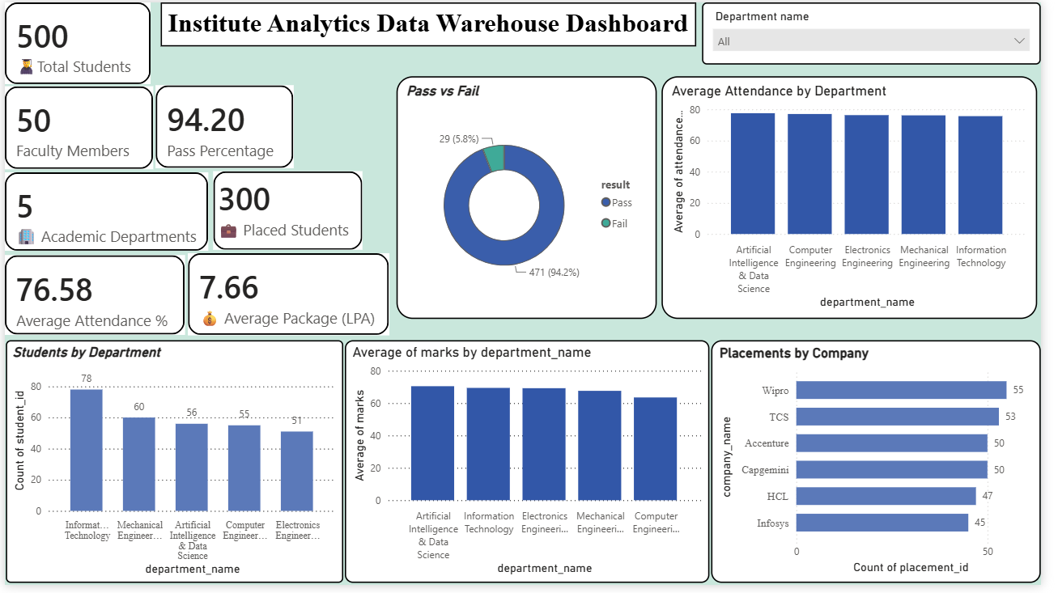

Slide 12
1. Challenges Faced
3. Learning Outcomes
Database configuration and connectivity issues
Validation of generated datasets
Designing meaningful analytical queries
Creating an interactive dashboard layout
Ensuring data consistency across tables
Understanding of Data Warehousing concepts
Practical experience with ETL pipelines
SQL query development and analytics
Database management using SQLite
Power BI dashboard creation
Business intelligence and data visualization skills
Data modelling concepts
Dashboard design principles
Data quality management
2. Solutions Implemented
Automated ETL scripts using Python
SQL-based validation checks
Structured database design
Interactive Power BI visualizations

Slide 13
Conclusion & Future Scope
The Institute Analytics Data Warehouse successfully integrates data from multiple institutional sources into a centralized repository.
The project enables efficient storage, analysis, and visualization of educational data through SQL analytics and Power BI dashboards.
The system improves reporting efficiency, data accessibility, and decision-making capabilities for educational institutions.
The project demonstrates the complete lifecycle of a Data Warehouse solution, from data generation and ETL processing to analytics and dashboard reporting.
Future Scope
Real-time data integration
Cloud-based deployment (AWS/Azure)
Machine Learning-based student performance prediction
Placement forecasting and analytics
Automated report generation
Role-based dashboard access
Mobile-friendly dashboard solutions

Slide 14
Thank You
(Questions & Answers)

